Slide 1
DATA PROVENENCE USING SQLITE3
Raya Rakesh
(22170307044)

Slide 2
TABLE OF CONTENTS
TITLE | PAGE NO’S
TECHNOLOGIES LEARNT | 3-7
WORK DONE DURING INTERNSHIP | 8-14
DATA FLOW DIAGRAMS | 15-21
OUTPUT SCREEN | 22
APPLICATIONS AND FUTURE SCOPE | 23
CONCLUSION | 24
ANY QUESTIONS | 25
THANKYOU SLIDE | 26

Slide 3




TECHNOLOGIES LEARNT
SQLite
Python along with its layout kit
PyQt tool
PyUIC

Slide 4
SQLITE
SQLite is a relational database management system contained in a C library
In contrast to many other database management systems, SQLite is not a client–server database engine
SQLite is not a client-server database engine. Rather, it is embedded into the end program
SQLite is ACID-compliant and implements most of the SQL standard, generally following PostgreSQL syntax

Slide 5
PYTHON
Python is a general-purpose coding language—which means that, unlike HTML, CSS, and a JavaScript, it can be used for other types of programming and software development besides web development.
That includes back end development, software development, data science and writing system scripts among other things

Slide 6
PyQt
PyQt is a Python binding of the cross-platform GUI toolkit Qt, implemented as a Python plug-in PyQt is free software developed by the British firm Riverbank Computing
PyQt implements around 440 classes and over 6,000 functions and methods[ including:
A substantial set of GUI widgets
Classes for accessing SQL databases
An XML parser, etc.

Slide 7
Pyuic
Pyuic is a command-line tool included with PyQt
It converts Qt Designer files into python modules, and is equivalent to Qt's uic command-line tool
The pyuic reads a user interface definition file (.ui) in XML as generated by Qt Designer and creates corresponding Python module

Slide 8
WORK DONE DURING INTERNSHIP
The project(Data Provenence using SQLite) that I have worked upon during my internship comprises of four modules. The first module deals with the registration and login of authenticated users
The second module deals with the details that has to be stored, while updating the data in the database
The third module deals with the exporting of Provenance data into a comma separated file
The final module deals with the creation of provenance reports

Slide 9
WORK DONE DURING INTERNSHIP
For this project sqlite3 tool was used to create the data base and to track the changes to that data base
Authorized User Details as well as customer are to be provided as Input to the system, using the corresponding user interfaces

Slide 10
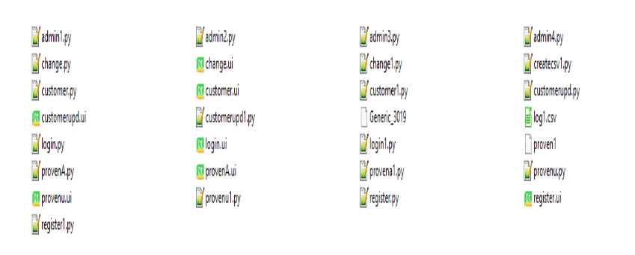
WORK DONE DURING INTERNSHIP
fig 1 Files created during the project

Slide 11
WORK DONE DURING INTERNSHIP
Previous Slide screenshot showed different files created during this projects. There were mainly three different file types
(1) .py files (2) .ui file (3).txt file
.ui files are the user interface files, created by using PyQt layout editor
.py files are python program files created either manually, or automatically

Slide 12
WORK DONE DURING INTERNSHIP
For instance, each .ui file has a corresponding .py file that is created automatically by using the PyUIC tool.
.txt files contains the generic useful information about the project.
provena1.py, is the entry program for this project.
Execution of this python program leads to the entry screen (see fig-2)

Slide 13
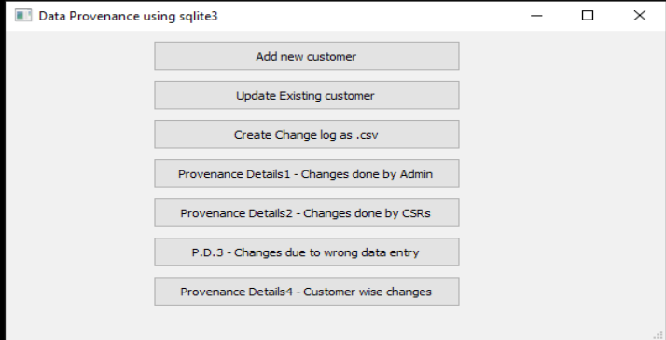
WORK DONE DURING INTERNSHIP
Fig-2 Entry screen

Slide 14
WORK DONE DURING INTERNSHIP
The entry screen consists of seven push buttons as shown in fig 2
Upon clicking the first button, customer1.py program is instantiated resulting in the customer screen that is useful to enter and store the customer details in the database
The second button results in a screen, where the authenticated users can perform the changes to the existing customer details
The third button leads to the creation of the comma separated value file
The remaining buttons gives the corresponding provenance details

Slide 15
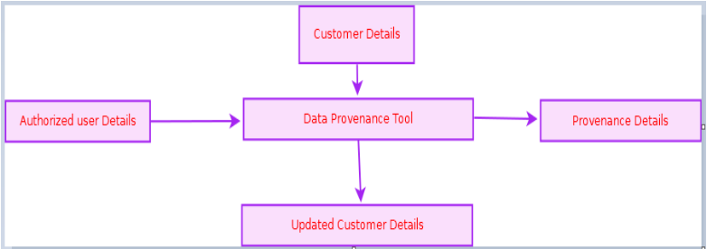
DATA FLOW DIAGRAM
Fig-3 DATA FLOW DIAGRAM

Slide 16
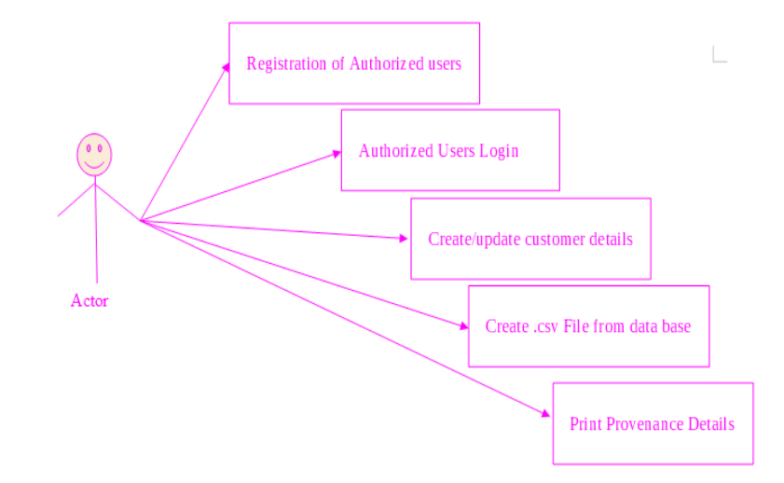
USECASE DIAGRAM
Fig-4 USE CASE DIAGRAM

Slide 17
DESCRIPTION OF USE CASE DIAGRAMS
Use case diagrams are usually referred to as behavior diagrams used to describe a set of actions (use cases) that some system or systems (subject) should or can perform in collaboration with one or more external users of the system (actors)
As we can see the user is interacting with system by a UI through which the customer can perform above mentioned operations like Registration of Authorized Users, Login as an authorized user, Perform DB changes, Create .csv file and output the provenance details

Slide 18
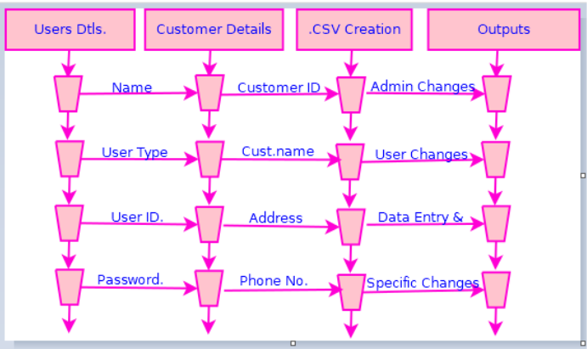
SEQUENCE DIAGRAMS
Fig-5 SEQUENCE DIAGRAM

Slide 19
DESCRIPTION OF SEQUENCE DIAGRAMS
A sequence diagram is an interaction diagram that shows how objects operate with one another and in what order
It is a construct of a message sequence chart
A sequence diagram shows object interactions arranged in time sequence
From figure 5 which is a sequence diagram , it can be observed that the authorized user can perform the needed changes, and the changes done by them will be produced as output

Slide 20
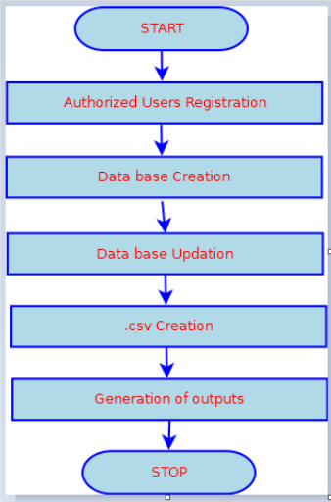
ACTIVITY DIAGRAM
Fig-6 ACTIVITY DIAGRAM

Slide 21
DESCRIPTION OF ACTIVITY DIAGRAMS
Activity diagram is another important UML diagram used to describe dynamic aspects of the system
It is basically a flow chart to represent the flow from one activity to another activity
So, the control flow is drawn from one operation to another
From fig 6 we can see that first Authorized user save to register themselves, perform the needed DB changes, create the comma separated value file and finally produce the provenance details.

Slide 22
OUTPUT SCREEN
Fig 7- OUTPUT SCREEN

Slide 23
APPLICATIONS AND FUTURE SCOPE
Applications
Security Applications that need to track DB changes
Banking and Military Applications
Future Scope
As of now, the system is implemented by using sqlite3.
Application of this project to other sql databases like postgresql need to be explored

Slide 24
CONCLUSION
This project entitled “ Data Provenance using sqlite3.”useful to the organizations in maintaining the provenance details
It is very useful to the small scale organizations, which rely on small DB tools like sqlite3
This project finally leads to the improvement of quality of data

Slide 25
ANY QUESTIONS ???

Slide 26
THANK YOU!!!

